Slide 1
Unit No 5: Data sharing and collaboration and Integration

Slide 2
Explore more complex data engineering challenges and solutions. Data Integration: Integrating data from different sources, Automating data pipelines. Excel Automation and Visual Basic for Applications (VBA): Macro recording and editing, User-defined functions (UDFs), Error handling and debugging. Power BI Sharing and Collaboration: Publishing and sharing reports, Collaboration features and workspaces, Power BI gateways for on-premises data access. Sharing and Collaboration in Tableau: Publishing and sharing dashboards, User roles and permissions.

Slide 3
complex data engineering challenges and solutions.
1. Data Ingestion Challenges
2. Data Integration Challenges
3. Data Storage Challenges
4. Data Processing Challenges
5. Data Quality and Governance Challenges
6. Data Pipeline Orchestration Challenges

Slide 4
1. Data Ingestion Challenges
One of the problems you might face in the first place while implementing a data engineering approach is connected to data ingestion.
The main issue here lies in the variety of data as information comes from diverse sources with different formats and structures.
Thus, it requires transformation before further processing and analysis.
You should think about encompassing efficient and scalable data ingestion systems to handle large volumes of data and process it in real time.
On top of that, we can name data integrity and quality assurance as another challenge.
Inaccurate or inconsistent data can lead to incorrect analysis and insights.
So it’s a good idea to implement data validation and cleansing processes in order to identify and address data quality issues during ingestion.

Slide 5
2. Data Integration Challenges
The next one of the problems we can highlight is data integration related to the connectivity of software solutions and data itself.
One of the primary goals of any data engineering project is to effectively connect disparate information sources and integrate data from a range of systems.
That, in and of itself, can be a challenge when you’re dealing with legacy systems that simply don’t have the built-in capabilities of connecting with modern software.
Apart from disparate systems, data that needs to be integrated can come with various formats, structures, and semantics.
Thus it may require data transformation, mapping, and schema alignment to ensure compatibility and coherence across the integrated dataset.

Slide 6
3. Data Storage Challenges
There are two key challenges in the area of data storage.
The first one is about accommodating the increasing volumes of datasets.
For example, data engineers can leverage options like distributed file systems and cloud-based storage services that can be easily expanded as data requirements grow, without compromising performance or incurring excessive costs.
The second challenge is data organization and retrieval. With massive amounts of data stored across various systems, it can get tricky to organize data in a way that allows for efficient and fast retrieval.
Effective data indexing, partitioning, and data structure design are crucial to optimize data access patterns and minimize retrieval time.
Data engineers also need to consider the use of compression techniques and data encoding methods to optimize storage space utilization without sacrificing data integrity or accessibility.

Slide 7
4. Data Processing Challenges
Data from mobile apps, IoT devices, and other platforms is constantly generated.
It’s easy to get overwhelmed by the seemingly never-ending influx of data.
Traditional processing techniques may struggle to handle such large volumes efficiently.
To address this challenge, data engineers often employ distributed computing frameworks, such as Apache Hadoop or Apache Spark, which enable parallel processing across a cluster of machines, allowing for faster and more scalable data processing.
Another issue that may arise within this category is that data may be incomplete, contain errors, or exhibit inconsistencies, which can impact the accuracy and validity of analytical results.
If many systems are using the same digital information and there are no real-time updates, inaccuracies can appear.
Naturally, this is something you want to avoid because poor-quality data does nothing for your business.
A possible solution to this data engineering challenge is to establish a comprehensive data management strategy with a data governance plan.
Doing so will help ensure that all data-related activities have someone in charge and that there are policies in place that help maintain the integrity of all your digital information.

Slide 8
5. Data Quality and Governance Challenges
Data quality and reliability may cause additional issues in the data engineering field.
That’s why it’s important to continuously implement data validation and cleansing practices to detect and handle data quality issues.
This includes outlier detection, data imputation, and data validation rules.
Another challenge you may encounter is having to deal with regulatory compliance.
The best way to deal with this is a combination of practices. Of course, it’s a good idea to keep monitoring any laws that may affect your business or even hire legal counsel.
However, another good option is to work with data engineering specialists that have expertise in building compliant platforms and can share best practices with you.

Slide 9
6. Data Pipeline Orchestration Challenges
Data pipelines orchestration can be quite complex and involve multiple stages and dependencies.
This can be a challenge as coordinating and managing the execution of various data processing tasks across different systems or components is not an easy feat.
Data dependencies may exist between different processing stages or tasks, where the output of one task serves as the input for another.
Thus managing these dependencies and ensuring the timely availability of required data inputs can be complex.
On top of that, while working with data pipelines, you may encounter various issues such as network failures, hardware failures, or errors in processing tasks.
To overcome these challenges, data engineers employ robust orchestration frameworks, implement fault-tolerant designs, and plan for scalability.
It’s also a good idea to implement monitoring and troubleshooting tools.
These practices help enable efficient and reliable data processing and ensure that you have a smooth flow of data through the pipelines.

Slide 10
Automating data pipelines
Data pipeline automation is the process of automating the flow of data from one system or application to another, often across different platforms or technologies.
This enables extracting the data from multiple sources, preparing and transforming the data and making it ready to be used in production, so it can be consumed by services like business applications and analytics solutions.
Automating the data pipeline is more efficient and cost-effective than manually moving the data between systems.
The automated process also improves data quality and helps managing data at scale.

Slide 11
What is a Data Pipeline?
A data pipeline is a series of steps or stages that data goes through in order to be processed, transformed and stored in a usable format. Data pipelines usually comprise multiple stages, including:
Data Ingestion: Collecting the data from databases, APIs, microservices, applications and other sources, and adding it to the pipeline.
Data Processing: Cleaning, validating, transforming and enriching the data to make it usable and useful.
Data Storage: Putting the data in a database, data warehouse, or other solution so it is accessible for future use.
Data Analysis: Analyzing the data to generate insights for informing business decisions. Methods like ML and predictive analytics are used.
Data Visualization: Presenting the data in an accessible manner on dashboards, reports, push notifications, etc.
As you can see, the data needs to be transferred between different systems and applications to progress in the pipeline.

Slide 12
What are the Benefits of Data Pipeline Automation?
Efficiency and Productivity: Automation reduces the amount of work required to transfer and process data in the pipeline, update data columns, etc. Without having to manually complete these data-related tasks, the process can be faster and require less manual effort, which helps improve efficiency and reduce errors in data points.
Better Data Quality: Standardization derives from automation. By standardizing the way data is moved in the pipeline, regardless of its source or format, the risk of errors, oversights or drift is reduced. This makes the data consistent, more accurate, always up-to-date, and, as a result, of higher quality.
Faster and More Effective Insights: Better data quality also informs better and faster insights, which gives businesses a competitive advantage since they can extract more value from their data. This could include business insights or data engineering insights, like duplicate data or tracking how data changed.

Slide 13
Process Simplification: Automation of the data pipeline process helps simplify the tedious tasks related to the data pipeline process, like connecting multiple sources, cloudification, or cleaning up columns from irrelevant commas. This drives productivity, but also improves the data engineering work experience.
Cost Reduction: By improving data quality, reducing the need of manual labor and making data useful faster, businesses can cut costs associated with risks, mistakes and human errors.
Scalability: Automated data pipelines are easier to scale as they can be configured to scale horizontally or vertically based on workload demands, and resources can be optimized for efficiency. This allows for the pipeline to easily handle increased data volumes and processing requirements without requiring significant manual intervention or reconfiguration.

Slide 14
Collaboration features and workspaces in power bi
You need a Power BI Pro license to share your content.
The people you share it with do too, or the content needs to be in a workspace in a Premium capacity.
When you share a dashboard or report, recipients can view it and interact with it. If you give them permission, they can edit it, make a copy of it, and share it with their coworkers.
They see the same data that you see in the dashboard or report.
They have access to all the data in the underlying dataset, unless row-level security (RLS) is applied.

Slide 15
Excel Automation and Visual Basic for Applications (VBA)
Excel VBA , short for Visual Basic for Applications, is a programming language that empowers users to automate tasks and create personalized solutions within Microsoft Excel.
It enables users to create macros, which are instructions that automatically perform repetitive tasks.
VBA allows users to use built-in functions, as well as user-defined functions.
VBA functions work in the same way as formulas in Excel and can be used to perform repetitive tasks.
Users can create custom functions for any actions and then access the functions from a cell or a direct reference from a cell.

Slide 16
User-defined functions (UDFs)
UDF is a custom function that takes data, performs a calculation, and returns the desired result.
The source data can be numbers, text, dates, booleans, and even arrays.
The result of calculations can be a value of any type that Excel works with or an array of such values.
How to create a custom function in Excel?
First of all, you need to open the Visual Basic Editor (VBE). Please keep in mind that it just opens in a new window and does not close your Excel spreadsheet.
The easiest way to open VBE is by using a keyboard shortcut - Alt + F11. It's fast, simple and there is no need to customize the Ribbon or Quick Access Toolbar.

Slide 17
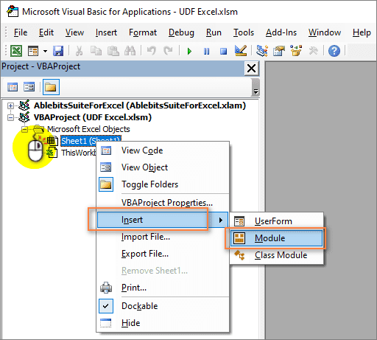
Before we start, let's go through the rules by which UDFs are created:
A user defined function always begins with “Function” and ends with “End Function”.
“Function” is followed by the name of the function. This is a title you create and give to your function so that you could identify and use it later. This name must not contain spaces. If you want to separate words, use underscores. For example, Count_Words.
Also, the name also cannot be the same as the names of standard Excel functions. If you do this, then the standard function will always be executed.
The name of the user defined function cannot match the addresses of the cells in the worksheet. For example, the name ABC1234 is invalid.

Slide 18
Next, the arguments of the function are usually listed in parentheses. This is the data with which it will work. There can be one or several arguments. If you have multiple arguments, you need to list them separated by commas.
If the functions inside the UDF do not use arguments (for example, NOW, TODAY, or RAND), then you can create a function with no arguments. Also, no arguments are needed if you are using a UDF to store constants (such as pi).
After that, specify the variables that the UDF uses. The type of these variables is indicated - number, date, text, array.
Then you put several VBA statements that perform calculations using the arguments passed to the function.
At the end, you should write a statement that assigns the final value to a variable with the same name as the function’s. This value gets returned to the formula from which the user defined function was called.
Custom function code can include comments. They will help you remember the purpose of a function and its operators. If you want to make any changes in the future, the comments will be very helpful.

Slide 19
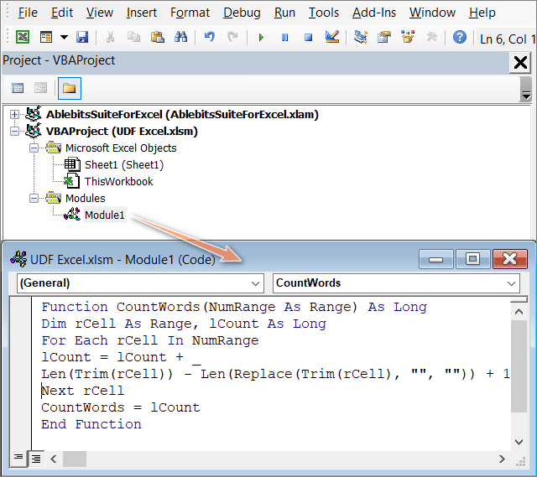
For starters, we create a custom function that will count the number of words in a range of cells.
As we indicate in parentheses the initial data it will use, NumRange As Range means that the UDF argument will be a range of values.
This function needs to return only one argument - the range of cells.

Slide 20
In the second line of code, we are declaring variables. As Long indicates that the result of the CountWords function will be an integer.
The Dim statement declares two variables of our function:
rCell is the variable of the range of cells in which we will count words.
lCount is an integer variable that will contain the number of words.
The For Each argument is designed to perform calculations on each item in a group of items (range of cells). This loop operator is used when the number of elements in the group is unknown.
Inside this loop, an operation that calculates the number of words is applied to the value of each and every cell:
Len (Trim(rCell)) - Len(Replace(Trim(rCell), " ", "")) + 1
As you can see, this is a regular Excel formula that uses the standard text functions: LEN, TRIM and REPLACE. Instead of the cell reference, we use the range variable rCell. Hence, for each cell of the range, we sequentially count the number of words in it.

Slide 21
The counted numbers are summed up and stored in the lCount variable:
lCount = lCount + Len (Trim(rCell)) - Len(Replace(Trim(rCell), " ", "")) + 1
When the loop is finished, the value of the variable is assigned to the function.
CountWords = lCount
The function returns the result of this variable to the cell of the worksheet, which is the total number of words.
It is this line of code that ensures that the function will return the lCount value to the cell from which it was called.

Slide 22
Error handling and debugging
VBA Errors
There are three types of errors in VBA:
Syntax
Compilation
Runtime
We use error handling to deal with runtime errors. Let’s have a look at each of these error types so that it is clear what a runtime error is.
Syntax Errors
If you have used VBA for any length of time you will have seen a syntax error. When you type a line and press return, VBA will evaluate the syntax and if it is not correct it will display an error message.
For example if you type If and forget the Then keyword, VBA will display the following error message.
Syntax errors relate to one line only. They occur when the syntax of one line is incorrect.

Slide 23
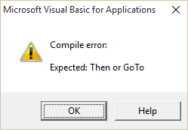
2. Compilation Errors
Compilation errors occur over more than one line. The syntax is correct on a single line but is incorrect when all the project code is taken into account.
Examples of compilation errors are:
If statement without corresponding End If statement
For without Next
Select without End Select
Calling a Sub or Function that does not exist
Calling a Sub or Function with the wrong parameters
Giving a Sub or Function the same name as a module
Variables not declared(Option Explicit must be present at the top of the module)

Slide 24
Using Debug->Compile
To find compilation errors, we use Debug->Compile VBA Project from the Visual Basic menu.
When you select Debug->Compile, VBA displays the first error it comes across.
When this error is fixed, you can run Compile again and VBA will then find the next error.
Debug->Compile will also include syntax errors in it’s search which is very useful.
If there are no errors left and you run Debug->Compile , it may appear that nothing happened. However, “Compile” will be grayed out in the Debug menu. This means your application has no compilation errors at the current time.
Debug->Compile Error Summary
Debug->Compile finds compilation(project wide) errors.
It will also find syntax errors.
It finds one error each time you use it.
When there are no compilation errors left the Compile option will appear grayed out in the menu.

Slide 25
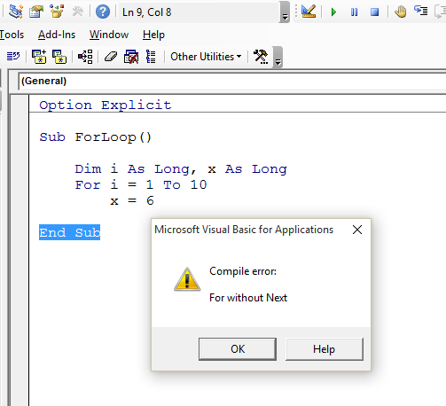
3. Runtime Errors
Runtime errors occur when your application is running. They are normally outside of your control but can be caused by errors in your code.
For example, imagine your application reads from an external workbook. If this file gets deleted then VBA will display an error when your code tries to open it.
Other examples of runtime errors are
a database not being available
the user entering invalid data
a cell containing text instead of a number

Slide 26
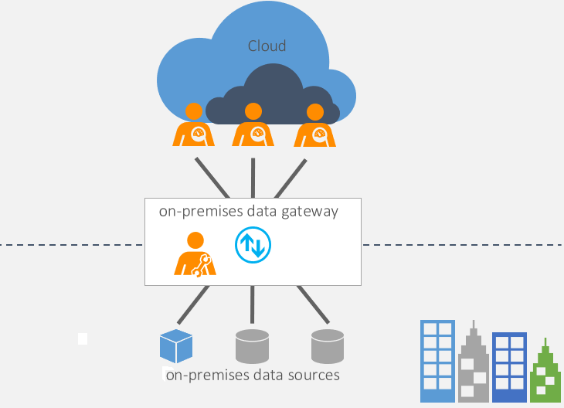
Power BI gateways for on-premises data access.
The on-premises data gateway acts as a bridge to provide quick and secure data transfer between on-premises data (data that isn't in the cloud) and several Microsoft cloud services.
These cloud services include Power BI, PowerApps, Power Automate, Azure Analysis Services, and Azure Logic Apps.
By using a gateway, organizations can keep databases and other data sources on their on-premises networks, yet securely use that on-premises data in cloud services.

Slide 27
Types of gateways
There are three different types of gateways, each for a different scenario:
On-premises data gateway: Allows multiple users to connect to multiple on-premises data sources. With a single gateway installation, you can use an on-premises data gateway with all supported services. This gateway is well-suited to complex scenarios in which multiple people access multiple data sources.
On-premises data gateway (personal mode): Allows one user to connect to sources and can’t be shared with others. An on-premises data gateway (personal mode) can only be used with Power BI. This gateway is well-suited to scenarios in which you’re the only person who creates reports, and you don't need to share any data sources with others.
Virtual network data gateway: Allows multiple users to connect to multiple data sources that are secured by virtual networks. No installation is required because it's a Microsoft managed service. This gateway is well-suited to complex scenarios in which multiple people access multiple data sources.

Slide 28
Use a gateway
There are five main steps for using a gateway:
Download and install the gateway on a local computer.
Configure the gateway based on your firewall and other network requirements.
Add gateway admins who can also manage and administer other network requirements.
Use the gateway to refresh an on-premises data source.
Troubleshoot issues with the gateway.

Slide 29
User roles and permissions
Adding a user to Tableau Cloud requires an available license. (Users can also be added as unlicensed and configured so they will consume a license only when they first sign in.
For each site the user belongs to they have exactly one site role, restricted by their license. A user has permissions for content on the site, restricted by what their site role allows.
Licenses and site roles apply to users. Permission capabilities apply to content.
Licenses are assigned to a user when they are created (or sign in for the first time) on the Tableau Server or Tableau Cloud site. Users are licensed as a Creator, Explorer, or Viewer.
License levels are consumed based on the maximum site role a user can have on that server.
Site Administrator Creator and Creator site roles use a Creator license.
Site Administrator Explorer, Explorer (can publish), and Explorer site roles use at least an Explorer license.
Viewer site role uses at least a Viewer license.
An unlicensed user can exist on the site, but they cannot sign in unless they were added with grant site role on sign in.

Slide 30
For Tableau Cloud, a user consumes a license per site and has only one site role.
Site roles are assigned to a user for each site they are a member of.
Site roles determine the maximum capabilities a user can have in that site. (For example, a user with a site role of Viewer will never be able to download a data source even if that capability is explicitly granted to them on a specific data source.)
Site roles do not inherently grant any capabilities in and of themselves—with the exception of the administrator site roles. Administrators always have all capabilities applicable to their license level.

Slide 31
Permissions consist of capabilities, like the ability to save to a project, web edit a workbook, connect to a data source, etc. They apply to group or user on a specific piece of content (project, data source, workbook, view, or flow).
Permission capabilities are not given to a group or user in a vacuum but rather in the context of content. A user can have different capabilities for different content assets.
Permissions are evaluated based on the interplay of a user’s site role and the permission rules for that user or any groups they are members of.
Some actions such as web authoring might require combinations of capabilities.

Slide 32
Publishing and sharing dashboards in tableau:
When you want to share a workbook with your colleagues, you can publish it to Tableau Server or Tableau Cloud with a few simple clicks. There, other people can view it, interact with it, and even edit it if their server permissions allow.
Before you publish your workbook, make sure you know the following:
The name of the server and how you sign in to it. If your organization uses Tableau Cloud, you can click the Quick Connect link.
Any publishing guidelines your Tableau administrator might have, such as the name of the project you should publish to.

Slide 33
Publish your workbook
With the workbook open in Tableau Desktop, click the Share button in the toolbar.
If you aren’t already signed in to Tableau Server or Tableau Cloud, do so now. If you don’t have a site yet, you can create one on Tableau Cloud.
In the Publish Workbook dialog box, select the project to publish to.
Name the workbook according to whether you’re creating a new one or publishing over an existing one.
Under Data Sources, select Edit. For Authentication, select Allow refresh access or Embed password.
For some data connections, only one authentication option appears. If None shows, leave it set to that.

Slide 34
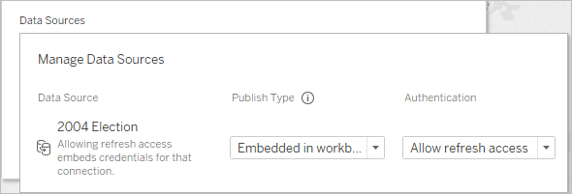
Click Publish.
If this is your first time publishing a workbook, test it on the server and work out any glitches before letting other users know the workbook is available.

Slide 35
Comprehensive Steps to Publish a Workbook
In Tableau Desktop, open the workbook you want to publish.
Select Server > Publish Workbook.
If the Publish Workbook option does not appear on the Server menu, make sure a worksheet or dashboard tab is active (not the Data Source tab).
If necessary, sign in to a server. For Tableau Cloud.
In the Publish Workbook dialog box, select the project, enter a name for the workbook, and add search tags.
Tags help users find related workbooks when they browse the server. Separate tags using a comma or space. To add a tag that contains a space, put the tag in quotation marks.
For Permissions, accept the default project settings.
Generally, a site administrator manages permissions on the server. If you think your workbook is an exception, work with your administrator to determine the best course of action, and see Set Permissions as You Publish a Data Source or Workbook.

Slide 36
For Data Sources, select Edit if you want to change whether the data is embedded in the workbook or published separately, or change how people authenticate with data sources.
If you’re publishing an extract and want to set up a refresh schedule, you must select Embed password or Allow refresh access.
If your workbook connects to a Tableau data source, we recommend embedding the password. If you instead choose to prompt users, they'll need additional permissions on the data source.
Configure Variable publishing options that are available for this workbook.
Click Publish.
(Optional) Set up a refresh schedule for each extract you published.
The publishing workflow guides you through these steps. For some data types you publish to Tableau Cloud, the publishing process starts Tableau Bridge on your computer

